Slide 1


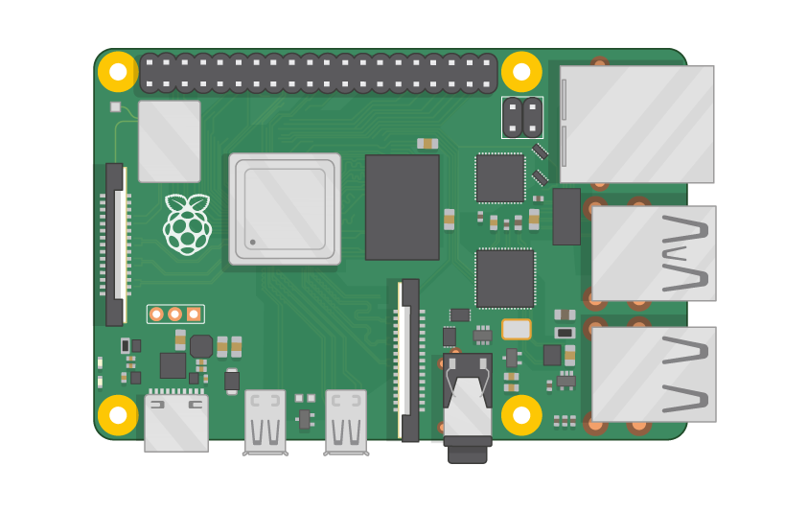
Raspberry Pi Master Class Day-14
Baby emotion recognition & Alert system

Slide 2
Table of Contents
01
02
03
04
Brain Computer Interface
Applications
Overview
Theory
Brain Controlled Robot
Discussion, Tech news & Q&A
Practical session
Interractive session

Slide 3
PREREQUISITES FOR THIS COURSE
Raspberry Pi 3 Model b/B+
16 GB SanDisk class 10 SD Card
Card reader
Laptop with Internet
Power Adapter – 5V 2Amps
USB B-Type Cable
Brainsense – BCI Device
Complete Robot Kit

Slide 4
Brain Computer Interface...
BCI ( Brain Computer Interface ) Communication using Thoughts of Brain (EEG) without using any Muscle control, Especially for Severely Paralyzed people

Slide 5
Bio Signal…
ECG
Electrocardiogram
EMG
Electromyogram
EEG
Electroencephalography
EOG
Electrooculogram
MEG
Magneto encephalography

Slide 6
Electroencephalography
Electroencephalography (EEG) is the recording of electrical activity along the scalp. EEG measures voltage fluctuations resulting from ionic current flows within the neurons of the brain
German physiologist and psychiatrist Hans Berger (1873–1941) recorded the first human EEG in 1924

Slide 7
EEG Bands…
Gamma
> 32Hz
Fastest waves which pass information rapidly and quietly
Alert | Anxious Thinking
Beta
15 – 32 Hz
Alpha
8 – 15 Hz
Relaxed State | Eye blink
Drowsiness | Idling in Adults
Theta
4 – 8 Hz
Delta
0.5 – 4 Hz
Adult slow wave sleep

Slide 8
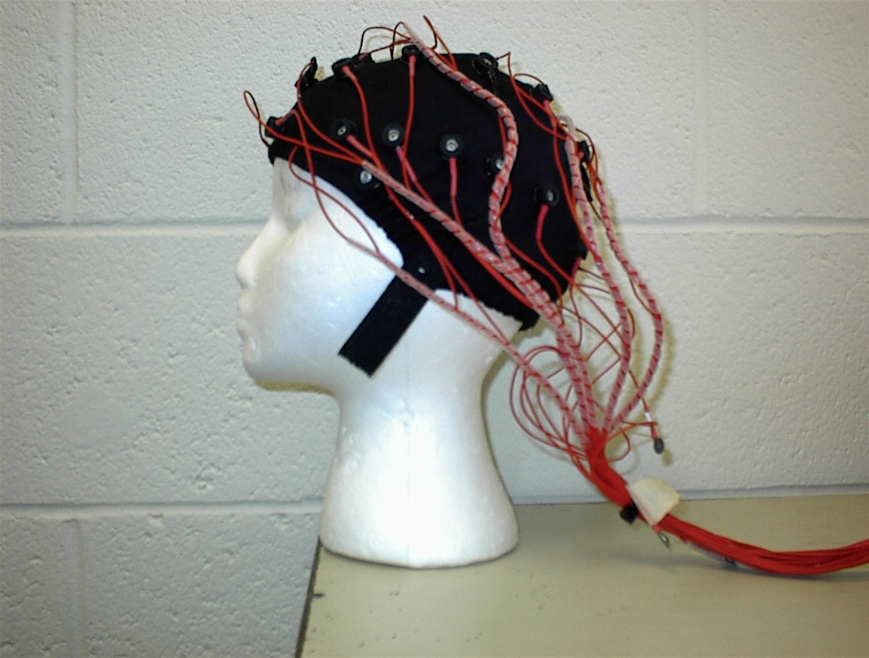
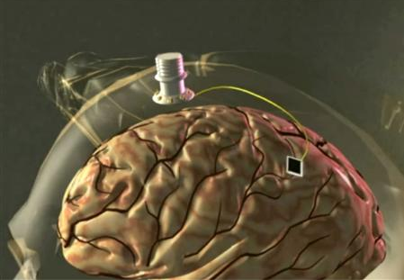
Types of Electrodes
Involves attaching electrodes directly to the brain tissue
Involves putting electrodes on the scalp of the patient and taking readings
INVASIVE
NON-INVASIVE

Slide 9
Anatomy…
PARIETAL LOBE
OCCIPITAL LOBE
FRONTAL LOBE
VISUAL CORTEX
TEMPORAL LOBE

Slide 10
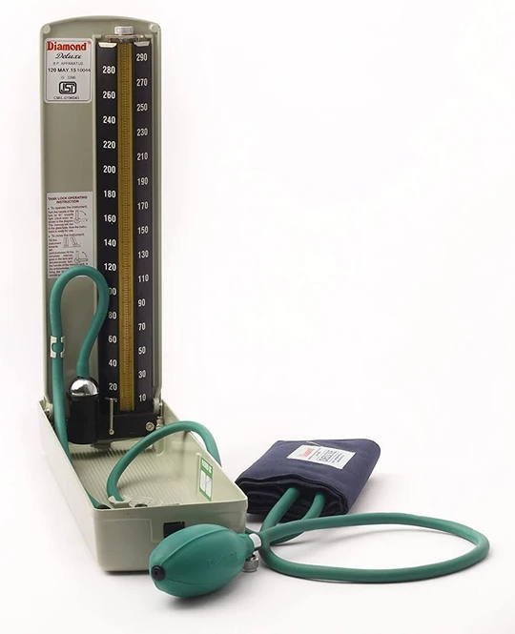
Q15 – Discussion
How Blood pressure device works?

Slide 11
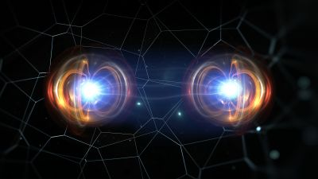
Q16 – Discussion
Quantum Theory?
Quantum Theory ?

Slide 12
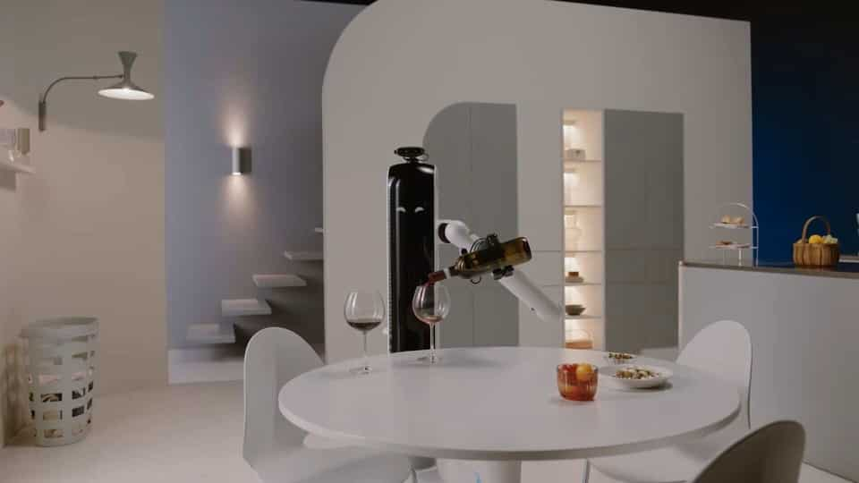
Samsung's new bots can pour a glass of wine, clean the house and keep an eye on your pets
Tech News - 15
Jan - 2021
Samsung JetBot 90 AI+, Samsung Bot Care, and Samsung Bot Handy come with some interesting features than the average robot.

Slide 13
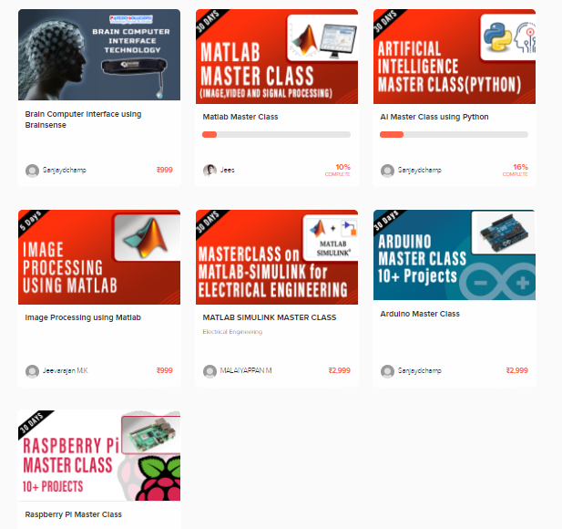
Thanks!
learn.pantechsolutions.net
www.pantechsolutions.net
“If you want to find the secrets of the universe, think in terms of energy, frequency & vibration”
-Nikola Tesla

